Slide 1
Query by Humming Searching Sep 16th
Jiarui Xu(Jerry), Alexander Lerch

Slide 2
This week
Read Audio Content Analysis v2, DTW part
Find humming data set.
Learn other methods like: Contour Extraction, HMM(compute the match score of the local alignment when both pitch and duration are used)
Find method to extract main melody

Slide 3
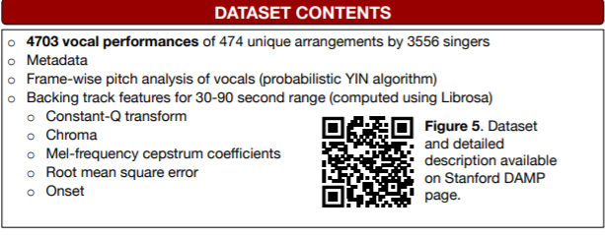
Humming dataset
Children's Song Dataset for Singing Voice Research
INTONATION: A DATASET OF QUALITY VOCAL PERFORMANCES REFINED BY SPECTRAL CLUSTERING ON PITCH CONGRUENCE
VOCALSET: A SINGING VOICE DATASET
SingingDatabase(opera)

Slide 4
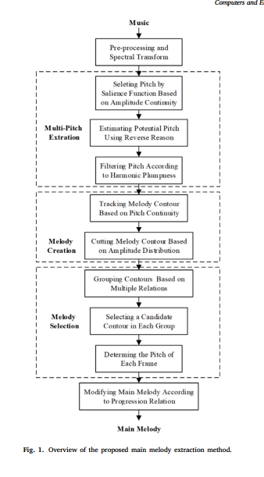
Extracting main melody
Main melody extraction from polyphonic music based on frequency amplitude and multi-octave relatio

Slide 5
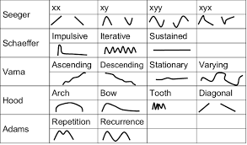
Distance Method: Contour, HMM
Contour
Hiden Markov Models

Slide 6
Next week
Modify the Main Melody extracting method.
Process LAKH
Start to work on front end to process the input signal using FFT, noise tolerance, robustness, ect.
Continue to learn algorithum like DTW, UTW, LDTW etc, and try to code something to realize.

Slide 7
Thank you!

